Slide 1
T99X171T00 Eagle LED change resistor SOP
(for Harvatek LED)
Cooper Kung
2023/11/08

Slide 2
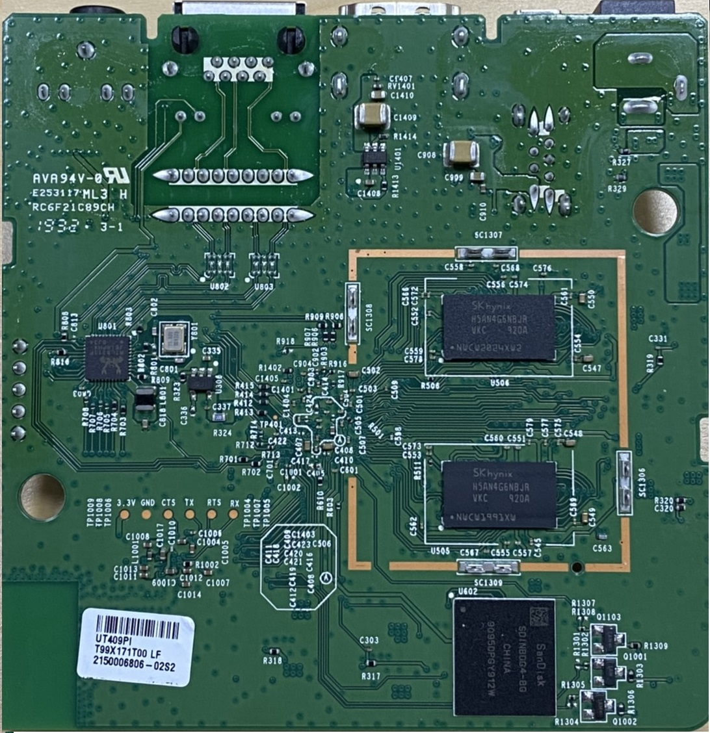
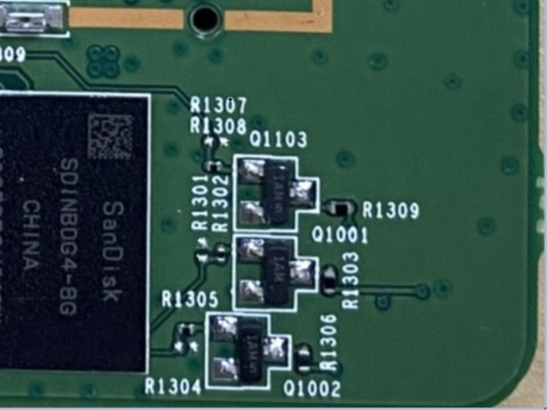
Change LED current limit resistors(R1309,R1303,R1306)
Change R1309 to 1.47K (0402 size)
Change R1303 to 1.05K (0402 size)
Change R1306 to 1.05K (0402 size)
R1309
R1303
R1306

Slide 3
Thank you

